Slide 1
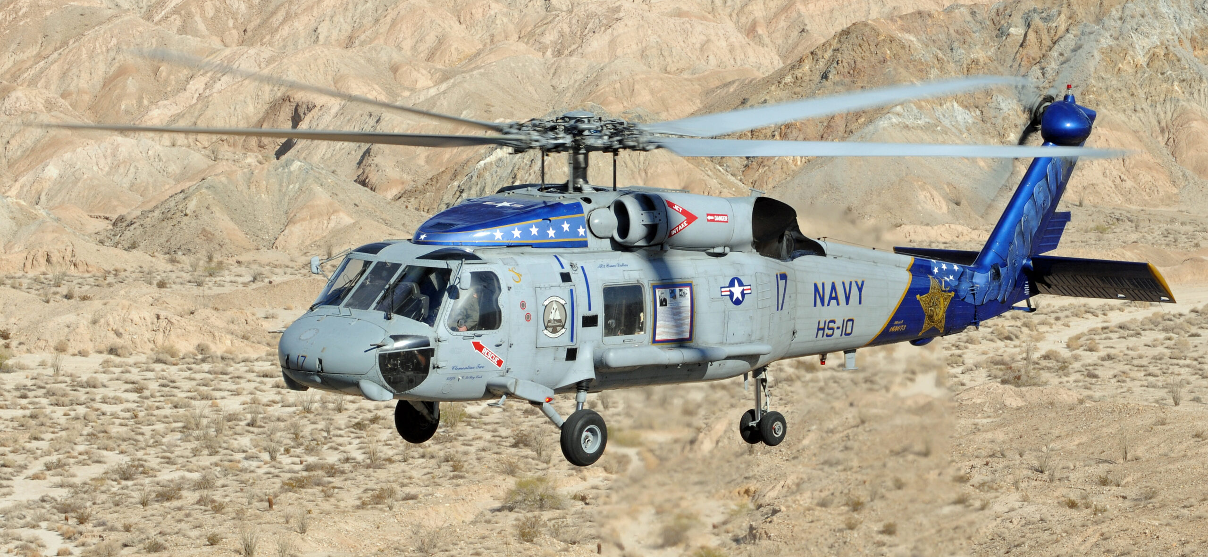
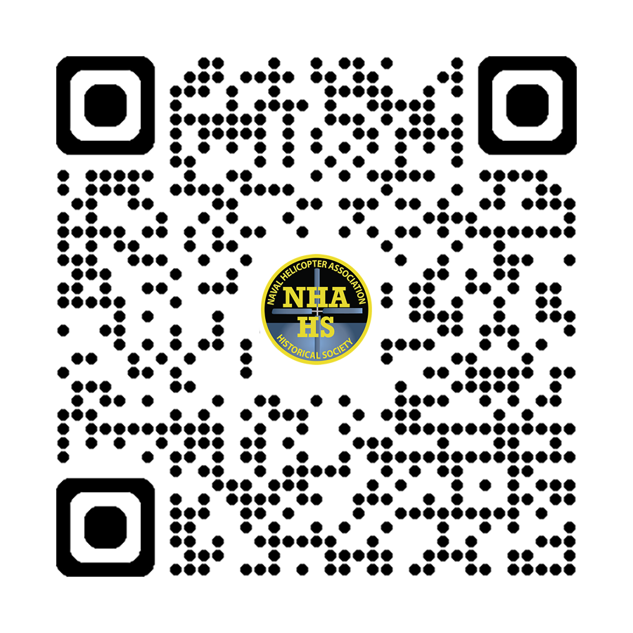
Mark Your Calendars!
Lassen Medal of Honor Memorial
Dedication Ceremony
1000 Saturday 25 January 2025
NBC/NASNI Front Gate
Friends and Families Welcome
Uniform Flight Suits/Casual Civilian Attire
Friday 24 Jan - I-Bar Reception - 1600 - Til
Saturday 25 Jan - Dedication Ceremony - 1000 -1100
HC-7 No Host Reception - Claim Jumper 1600 - Til
Wyndham SD Bayside - 1355 N. Harbor Drive
All Comers Welcome
Sunday 24 Jan - Mt. Soledad Lassen/Crew Plaque Dedication 1300-1400
Buy a Brick - Donate to the Project
A Perfect Gift for the Holidays!
Notes:
Our plan is to place a SH-60F Seahawk at the front gate.
This aircraft is painted in honor of CDR Clyde E. Lassen’s, USN (Ret.) Medal of Honor for the
100 Year Celebration of Naval Aviation in Feb of 2011
Used in Disestablishment Ceremony of HS-10 in July of 2012
The Navy is currently flying a family of Seahawks with the MH-60R and MH-60S so…
For those reasons… this aircraft was the next best option to Honor Clyde and his crew and be placed at the front gate of NASNI.
This aircraft is important and significant as it pays tribute to a Medal of Honor Winner CDR Clyde E. Lassen and his crew
as well as the thousands of personnel that pass through the gate of the Master Helicopter Base supporting what are 23 helicopter commands, 80 tenant commands and the Naval Aviation Depot, which is the largest aerospace employer in San Diego.
Here s a picture of Buno 164073 in flight.

